Slide 1

Regions’ Return? “Place Based” Policy Approaches and the UK Government’s Localism Agenda
URESG Seminar, Edinburgh, Jan 2015
David Bailey (Aston)
and Paul Hildreth (Salford)
* Note: Based on Bailey, Hildreth and De Propris, 2015 forthcoming

Slide 2
Today…
Touch on differences of space blind v place based approaches → what does this mean for industrial policy/regional development policy?
Identify limits / tensions in economics behind current government approaches (in England)
Ask what a genuine place based appraoch might mean for England → ‘missing space?’
Where next?

Slide 3
2013 issue of the Cambridge Journal of Regions, Economy and Society edited by Harry Geretsen, Philip McCann, Ron Martin and Peter Tyler on ‘The Future of Regional Policy’
Chapter in 2015 Volume Bailey et al, ed.s, New Perspectives on Industrial Policy for a Modern Britain. Oxford: OUP. Forthcoming 2015.

Slide 4
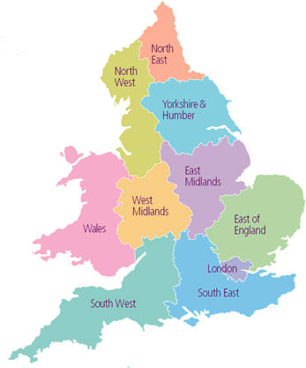
England: From ‘Regions’ to ‘LEPs’
To…..
From……

Slide 5
Changing Frameworks
* Most important for economy?
Labour Govt
Coalition Govt
Regional Planning, RDAs, Reg Ec Strategies
X
Region*
Region
Sub-region/City-Region
‘How we live and work’ and how the functional economy operates
LEP*
Local Authority
Local Authority
‘How we are governed’
Neighbourhood/ community
‘Where we live’
Neighbourhood/ community
Source: See Hildreth, P (2007) ‘The dynamics of place-shaping’

Slide 6
Political debates 1
‘Old’ system of RDAs not perfect BUT...
Coalition approach struggled to make clear what regional growth drivers / levers LEPs will really be able to influence
Voice of the English regions at EU level?
LEPs competing for resources?

Slide 7
Recentralisation or decentralisation?
Despite rhetoric, post 2010 policy implied a substantial recentralisation to Whitehall ?
Centralised industrial policy not likely to work
LEPs: transport, housing, planning, enterprise (?)
Business engagement?
RGF big cut in funding – needs to be much more scope for Local Authorities / LEPs to raise own finance: TiFs, bond issuing powers (US?), control over government budget

Slide 8

‘Policy Pizza?’
Pizza Menu
Today’s Special! – ‘New Local Growth’
Topped by a delicious scatter of policy initiatives and political rhetoric, on a base of underlying economic concepts

Slide 9
From ‘Pizza to Policy’ (or vice versa)
Pizza layer | Layers of policy | Examples
Scattering of cheese | Rhetoric | e.g. “create a fairer and more balanced economy”; “cities are engines of growth
Topping | Policy initiatives | e.g. LEPs; RGF; EZs; TIF etc
Base | Economic and conceptual framework
 | When | Dominant | Influences?
 | 1945 to mid 1970s | Neo-Keynesian
 | Mid -1970s to mid 1990s | Neo-Classical | Exogenous growth
 | Mid 1990s - 2010 | Neo-Classical | Endogenous growth
 | 2010 onwards | Neo-Classical | Space-blind, NEG, Placed-based approaches

Slide 10
Economics behind move to LEPs
Competing economic ideas in government: neo-classical perspective and also NEG and place-based approaches
Six key limitations of economics behind new approach:
1. A two region model
2. Tension in approach to cities outside London
3. Conditional Tone towards cities outside London
4. Limited outcomes in practice?
5. Bottom-up creation of LEPs → ‘right geography’?
6. What happens to LEPs not connected to a core city?

Slide 11
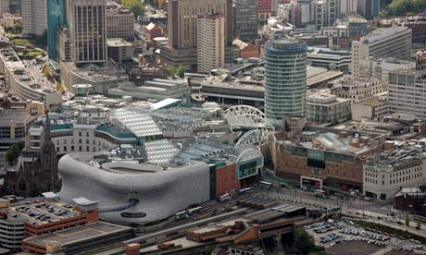
City Deals
Round One 'City Deals' offered eight British cities greater control over spending
Birmingham, Bristol, Leeds, Liverpool, Newcastle, Nottingham, Sheffield and Manchester reached agreement with Whitehall over devolved powers
Issue 4 – Genuine step forward or limited outcomes clouded in ‘smoke and mirrors’ and overall funding cuts?
Source: The Guardian

Slide 12
Outcome: a two region view of England?
Is there a tension between different frameworks? And how might it work out in practice in government?
Region 2 – e.g. Rest of the country (Midlands, North and South West)
Two region model of England, with privileged London and SE
Core Cities
Cities outside London viewed holistically or context for reducing costs via deregulation?
London
Region 1 – e.g. London and GSE
(London mega-city-region)
Source: Based on Hildreth and Bailey, 2012

Slide 13
TTW area
Variable economic geography
Newcastle
Tyneside
Sunderland
Harrogate
Teeside
Bradford
Leeds
Hull
York
Milton Keynes
Kirklees
Wakefield
Barnsley
Doncaster
Cambridge
Sheffield
Rotherham
London
Towns and cities (or parts of) with higher increasing return industrial sectors
Reading
Towns and cities with lower increasing return industrial sectors
Brighton
Hastings

Slide 14
→ ‘Missing Space’ between the ‘local’ and ‘national’?
Local
LEP
‘Missing Space’ between the ‘local’ and the ‘national’?
‘Missing Space’ – occurs because:
The ‘local’/LEP lacks sufficient depth and substance
LEP (outside larger city regions) lacks appropriate geography reflecting how economies work across space
Absence of Multi Level Governance
National

Slide 15
‘Place-based’ and ‘space-blind’ (‘people centred’) alternatives

Slide 16
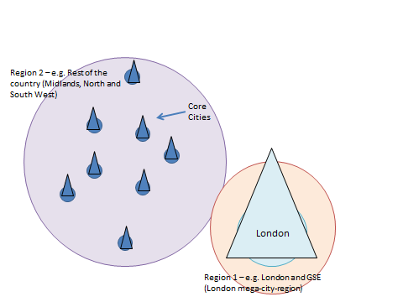
UK debates: 2 different & contrasting views on regional inequalities
One view -
Disparities driven by ‘people’ not ‘place’ characteristics
Hard to change ‘area effects’, focus investment to impact on ‘people’
Prioritise successful cities growth, even with more uneven development
Remove barriers to city growth (e.g. planning reform)
Localism okay: no evidence helps growth, but facilitates experimentation
(Overman and Gibbons, 2011)
i.e. it is about wage and price adjustments within a specific form of ‘NEG’ type market framework
Market adjustments
Another view –
Since 1980s, UK institutional business model relied on publically funded employment to compensate for weak private sector job creation
UK is over dependent on financial services (heavily concentrated in GSE) and a consumer spending model
Absence of a successful national manufacturing framework to address: fragmentation; limits to capacity; organisation of investment decisions and skills shortages
(Froud, Johal, Law, Lever and Williams, 2011 – CRESC)
i.e. it is about profound embedded institutional failure in long-standing UK national business model
Profound institutional failure

Slide 17
Place-based policy – key principles (1)
1. Globalisation
A globalised world has made space and place more important. Geography, history and institutions really matter in a local and regional context
4. Institutions
Institutions - specific institutional arrangements of any space is increasingly the filter through which economic activity takes hold in different places
Agglomerations - result of public as well as private decisions
2. Urban system
Urban system – heterogeneous not homogeneous
About - performance of the urban system as a whole, rather than just relatively successful cities
(Regions with average GDP per capita below 75% of national average accounted for 43% of growth across OECD 1995-2007)
3. Geography
Geography – distinctive characteristics of localities and regions really matter
Places – shaped by geographical, historical, social and institutional context
Potential – related to capacity to root economic activity in the local and institutional fabric
(The generation, acquisition and exchange of knowledge and the life blood of all firms is mediated and reflected in geography)
Source: Barca, McCann and Rodríguez-Pose (2012)

Slide 18
Place-based policy – key principles (2)
4. The state
Lacks ‘sense of community’ - aware that tends to limit its capacity to adapt its approach to different places
‘Capital city elites’ – prone to influence national policy making
Agglomerations - result of public as well as private decisions
5. The local
Under-development traps - limit and inhibit the growth potential of regions or perpetuate social exclusion. May relate to failure of local elites to act or because a place lacks effective institutions
Tackle - by new knowledge and ideas
7. Policy
Spatial targeting - appropriate bundles of public goods and a multi-governance approach , supported by conditional and outcome indicators
Appropriate institutions
Smart specialisation – embeddedness, relatedness, connectedness
8. Outcome
Outcome - to tap into the untapped potential of all regions in a coordinated and systematic way, taking into account the diverse variety of local knowledge, institutions and capabilities in different places
6. Knowledge
Knowledge - uncertain, embedded into localities
Uncovered - from public, private and community sectors by bottom-up participatory processes to build consensus and trust
Collaboration – local stakeholders and external actors
Source: Barca, McCann and Rodríguez-Pose (2012)

Slide 19
International debates: ‘Space-blind’ versus ‘Place-based’ Policy
 | ‘Space-blind’ (e.g. WDR 2009) | ‘Place-based’ (e.g. Barca Report, OECD)
Purpose | Facilitate agglomerations , migration and specialization for development | Promote realisation of growth potential in all regions, focusing on urban system as a whole
Urban system | Homogenous (in relation to city size) | Heterogeneous (not city size dependent) Agglomerations are not all natural
Geographical and historical context | Regions and localities follow standard development path | Geographical characteristics (i.e. economic social, cultural, history, institutional) of place really matter with multiple development paths
Institutions | Invest in provision of space-blind ‘universal’ public services (e.g. education, social services) | Design appropriate institutional structures and governance in context. Overcome ‘under-development traps’ due to capacity/unwillingness of ‘local elites’ through exogenous + endogenous interventions (MLG)
Solutions | Standardised: 1st order: spatially-blind institutions 2nd order: infrastructure to connect across distance 3rd order: sparingly spatially-targeted interventions | Design appropriate public good interventions and institutional frameworks in context of place
Knowledge | Predictable | Uncertain, embedded in locality and needs to be uncovered through bottom-up participatory processes to build consensus and trust
Role of central state | Design and provision of spatially-blind public services and appropriate infrastructure | Lacks ‘sense of community’, may support investments promoted by ‘capital city elites’

Slide 20
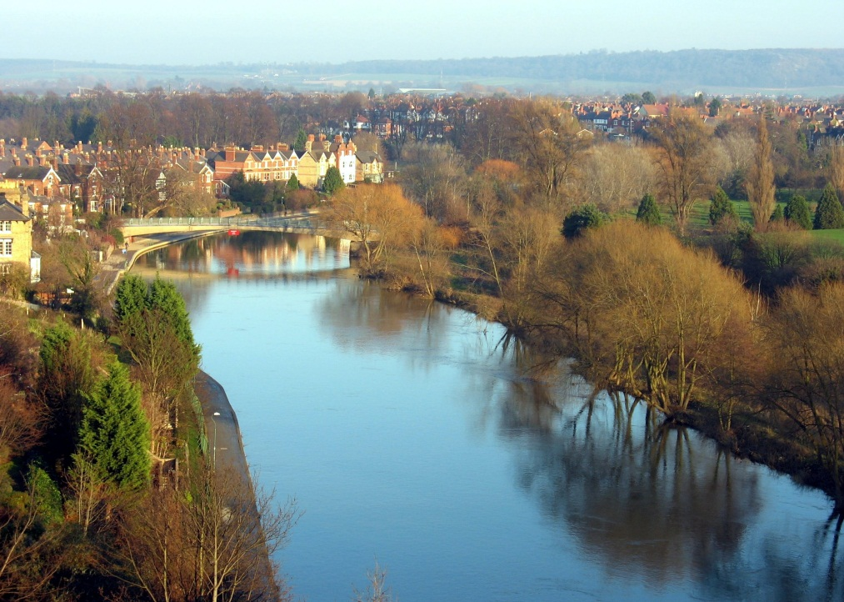

Visualisation of differences between space-blind and place-based policy approaches
“In essence, the differences between the space-neutral and the place-based approaches centre on the question of whether the territorial systems in evidence today are the result of a unique first-best solution to efficiency and space or rather of path dependency , sunk costs, and institutional issues. As such, the two approaches represent a different reading of the relationships between economic history and economic geography, giving rise to fundamentally different approaches”
(Barca, McCann and Rodríguez-Pose, 2012: page 141)
Place-based perspective?
Space-blind perspective?

Slide 21
Place Based approach → implications for BOTH ‘national’ & ‘local’ institutions

Slide 22
Why Whitehall may not sufficiently understand ‘place’
Why the ‘national’ might lack ‘sense of community’ and may support investments promoted by ‘capital city elites’
Culture of centralism
Culture of ‘conditional localism’
No holistic perspective of ‘place’
Short-term policy cycles
Absence of institutional memory
Internal rather than external focus
Policy driven by ‘rhetoric’ not strategy
‘Hollowing out’ of the central state (links to CRESC argument)
Un-spatial economic framework
Undue influence of London as the ‘global city’
  London/GSE favoured in investment, from Olympics, Cross Rail to London Gateway
  Golden triangle (London, Oxford and Cambridge) versus ‘Science Cities’
  Financial services favoured and absence of strategic approach to other sectors

Slide 23
3 models of local self-governance
Model of local self-governance | Key characteristics
‘Representative’ | Dominant model in Western Europe Incorporate European Charter Principles Legally and constitutionally based Local and State roles clear Strong local leadership
‘Conditional’ | More centrally driven model Example, UK under ‘new Labour’ 1997-2010 Local agendas driven by Central concerns Strongly performance management information based Governance through partnership
‘Community’ | Devolution direct from State to ‘community’ ‘Commissioning’ option ‘Community asset’ option Elements reflected in UK ‘Big Society’ ideas
How far have we really moved from a ‘conditional framework of local self-governance’?
Source: Hildreth, 2011

Slide 24
Also, challenge of ‘local’ for ‘place-based’ policy
‘Under-development traps’ may occur due to lack of capacity or unwillingness of ‘local elites’. Why? e.g.:
Lack of trust
  Within single local authority
  Across two (or more ) local authorities within ‘natural economy’
  Between two overlapping authorities in a two tier situation
Under-bounding
  Serious under-bounding of local authority
  Inappropriate bounding for LEP
Culture of ‘conditional localism’
  Priority of ‘local’ becomes to respond to the ‘national’, rather than local needs and priorities
Insufficient local capacity

Slide 25
Nottingham
Ashfield
Broxtowe
Gedling
Nottingham is a classic example of under-bounding.
This considerably constrains the ability to take strategic decisions at the metropolitan level, due to the constant need to negotiate and reach agreement with five District Councils and two County Councils
Derbyshire
Nottingham
Nottinghamshire
Erewash
Rushcliffe

Slide 26
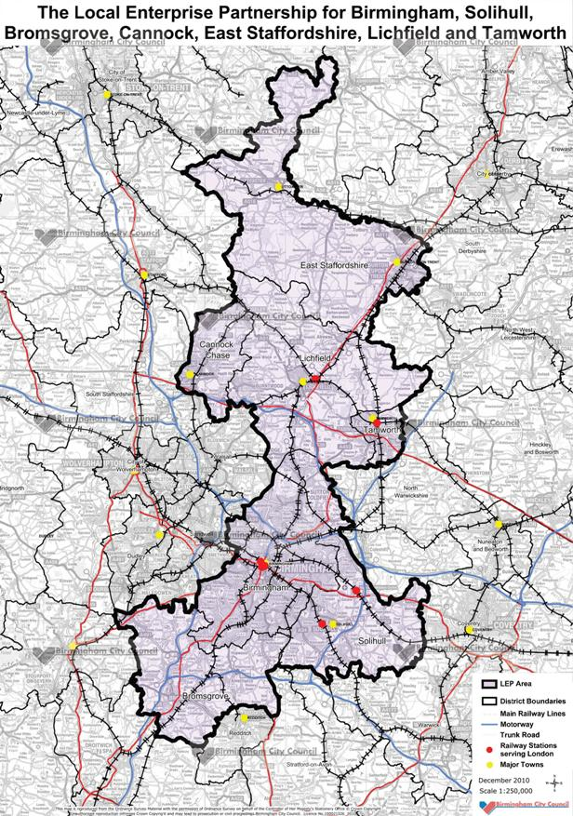
Birmingham, Black Country and Coventry
Greater Birmingham and Solihull LEP – strange boundaries?
Lichfield
Travel to work
Sandwell
Walsall
Wolverhampton
Dudley
Birmingham
Built-up area
Solihull
Coventry
Do LEPs reflect natural economies in practice?

Slide 27
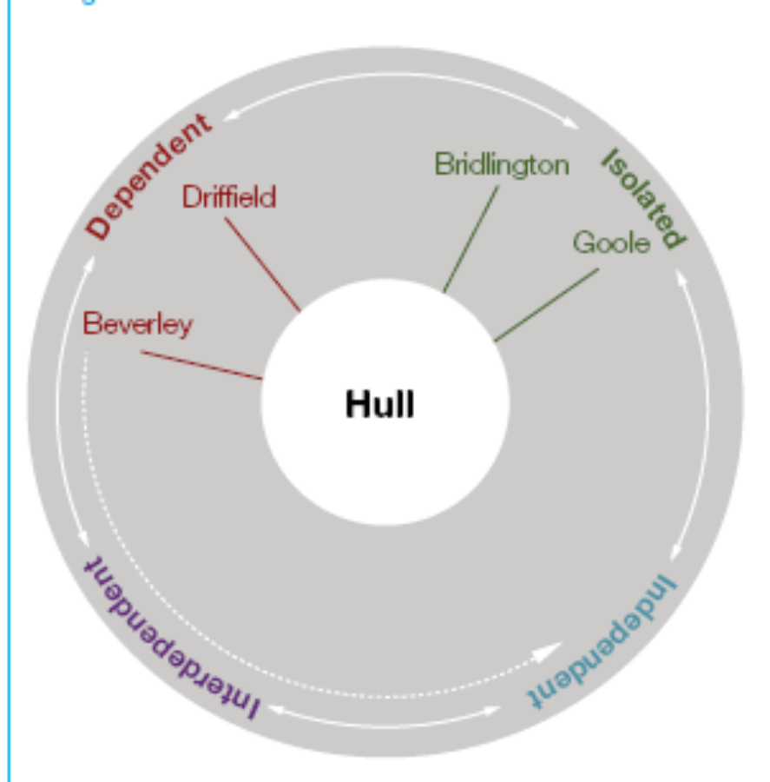
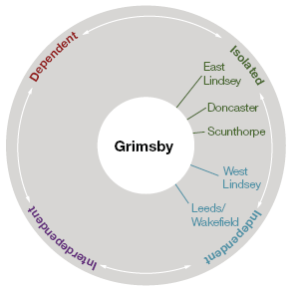
Hull and Humber Ports
What happens to places that are not connected with a Core City?

Slide 28
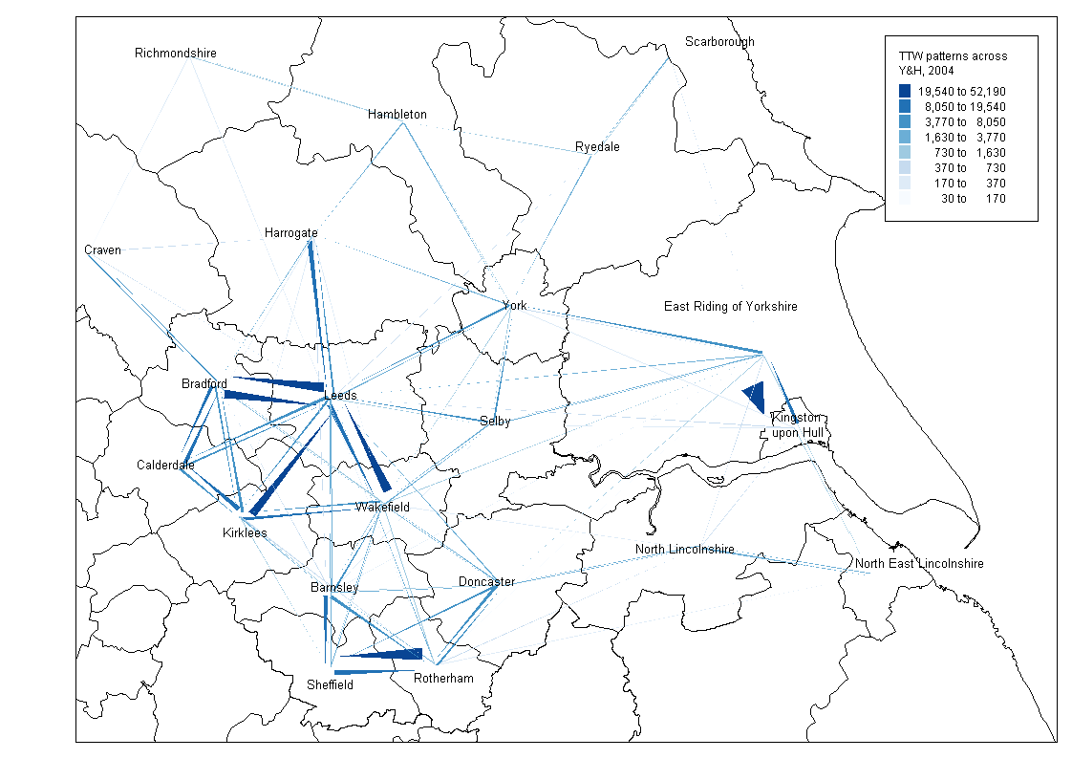
City relationship patterns Yorkshire and Humber
Leeds City Region
Harrogate – dependent city
Harrogate
York
- independent
Will we see a growing widening gap in economic and institutional capacity?
Bradford – inter-dependent city
Hull – isolated or dependent relationships
Hull and Humber Ports
Wakefield – dependent city
Calderdale
– isolated city
Barnsley – dependent city
Doncaster – isolated city
Grimsby – isolated or dependent relationships
Kirklees
- Dependent city
Sheffield City Region
NE Derbyshire - dependent
Bolsover – isolated city
Source: Work Foundation, SURF and Centre for Cities

Slide 29
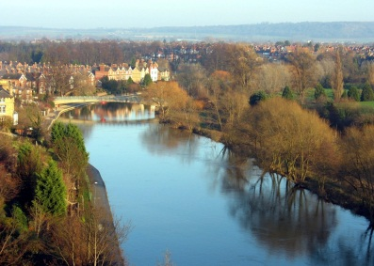
‘Space-blind’ (‘people-centred’) perspective of ‘missing space’
Facilitates experimentation e.g. City Deals
Geographical characteristics (history, culture, institutional) characteristics of ‘place’ not significant
With local discretion
‘Community localism’
Local
LEP
Invest in ‘space-blind’ universal public services
Under space-blind approach, ‘Missing Space’ not a problem that requires ‘place-based’ institutional solutions. Enable markets to adjust to reinforce expansion and movement to successful places. Smaller public sector should create more space for private sector (and ‘community localism’) to grow.
Re-centralisation of ex-RDA functions; rhetoric of ‘re-balancing not followed through in practice
National

Slide 30

‘Place-based’ perspective of the ‘missing space’
‘Local’ needs appropriate governance in context as well as external input/incentives
Geographical characteristics (history, culture, institutional) characteristics of ‘place’ do matter
Local
Multi-level governance to join-up ‘local’ to ‘national’ and fill ‘Missing Space’
LEP
‘Missing Space’ is a problem that needs to be filled with appropriate institutional and policy solutions e.g.:
Public and private inter-dependent (e.g. Olympics, innovation); Industrial policy as a process of discovery (Rodrick); Large firms and small firms as a ‘rainfall canopy ‘(Heseltine) (supply chains); “Open innovation” (Hutton)
Centre needs to work to improve understanding of ‘place’
National

Slide 31
Missing Space; Placed based Approaches
EU context – Smart specialisation
Not start from scratch, bring together actors to build on what there is; related variety; diversity
Links to modern ideas Industrial Policy: e.g. Dani Rodrick - IP as a discovery process

Slide 32
An alternative?

Slide 33
Conclusions 1
The case for ‘place-based’ policy not well understood in UK
Local Growth is explained in the ‘rhetoric’ of ‘place-based’ policy, but has attributes of a ‘space-blind’ approach in practice
  Little to suggest any re-balancing (indeed, the opposite)
  Growing institutional divide (e.g. in North between Manchester and Leeds and many of the rest) → divergent outcomes
There is an alternative
  Why Whitehall does not ‘get’ what place is + reform of the local. MLG important here.
  Conceptually, it requires thinking about a ‘missing space or ‘middle’, that better joins up and fills the gap between the ‘national’ and the ‘local’ → regionally based development strategies (IPPR/NEFC)
  Update: Heseltine? (Leaving aside fact not really accepted): governance/capacity LEPs. Bidding (RGF?). Accountability. Rather: city deals/Combined authorities? 2013 BIS Select Ctte report.

Slide 34
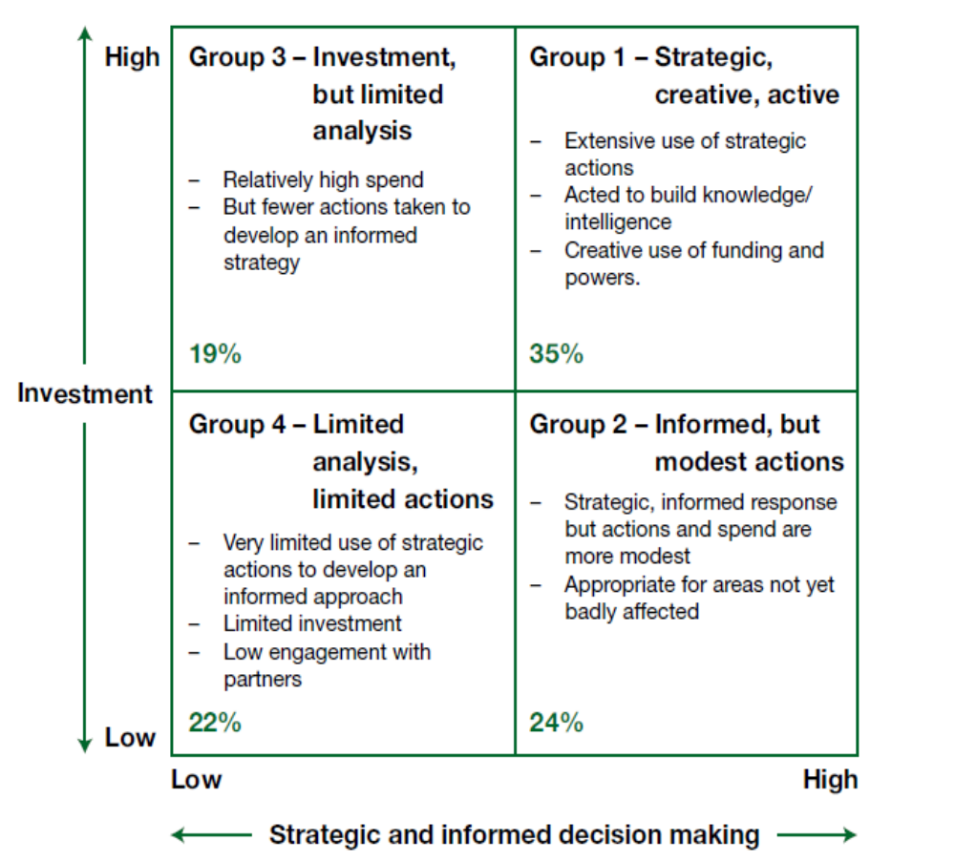
Role of LAs in recession:
(Audit Commission, 2009; Bailey & Chapain 2011)

Slide 35
Conclusions 2
LEPs/combined authorities need genuine powers and the ability to raise funding: for some cities, government listening?
Right scale? Intermediate ‘join up’ of work of LEPs between local and national level critical to use public monies effectively – minimum: intelligence and info gathering base, pursuing effective cluster and innovation strategies and accessing EU funding
Duty to cooperate?
RGF?

Slide 36
Thanks for listening!
Comments / questions welcome
D.Bailey@aston.ac.uk

