Slide 1

Unleashing Metro Growth
Charlotte Alldritt
Director, Public Service and Communities
Secretary RSA City Growth Commission

Slide 2
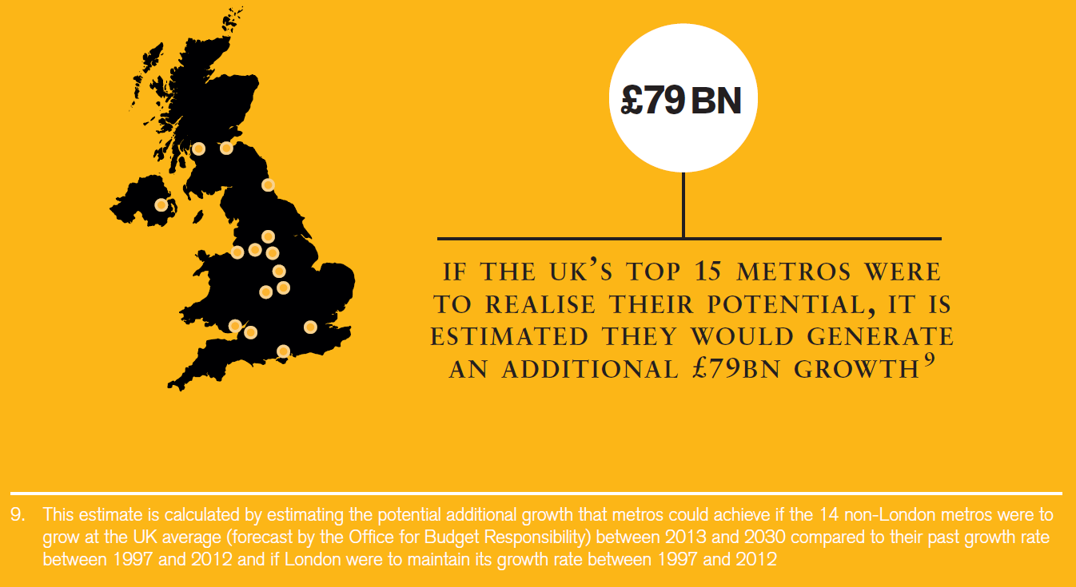
Unleashing value

Slide 3

Education and skills

Slide 4

Connectivity

Slide 5
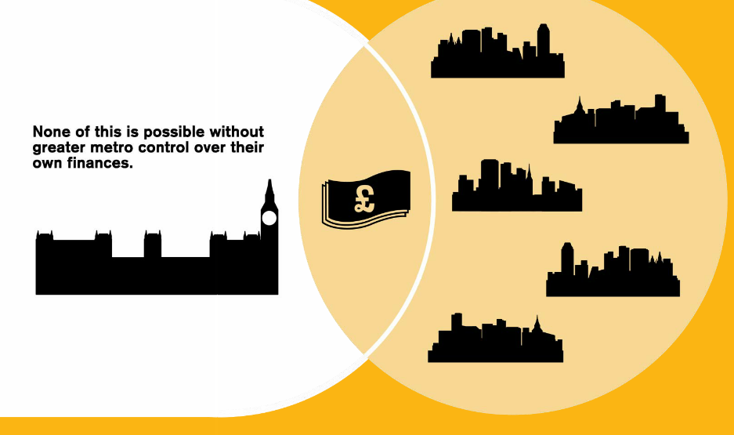
Fiscal devolution

Slide 6

Effective governance

Slide 7







Rapid policy progress

Slide 8
Not a done deal
Legislation: Needed to enact and enable existing commitments during first Parliamentary session.
Public Service Reform: Needed to improve outcomes and drive down costs, designed and delivered more effectively at local level.
Fiscal Devolution: The most mature city-regions should be able to borrow more flexibly.
Deficit reduction and a place-based Spending Review: Multi-year Local Government Finance settlements essential.
Capacity and Collaboration: Capacity varies between city-regions, but all need to build a track record of effective governance and risk management.
Notes:
Not a ‘done-deal’ – the agenda is still contingent on the election result and leadership from key individuals
City growth matters, framing salient economic and social issues – from healthcare to jobs.

Slide 9


Further Information
charlotte.alldritt@rsa.org.uk
www.rsa.org.uk
@RSA_PSC

Slide 10
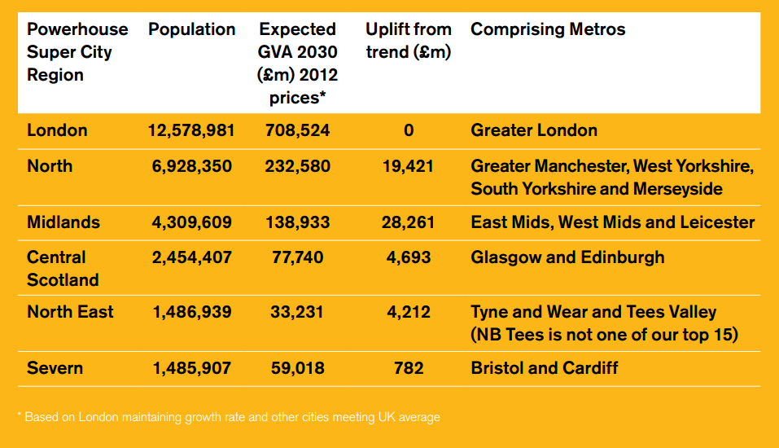
Appendix: Super City Regions

Slide 11
Appendix: Four ‘V’s
Voice – partnership working across city-region linked to functional economic area and its wider economic strategy;
Value – demonstrate value through data-driven accountability for outcomes (eg shifting into higher wage/sector economies);
Variation – bespoke deals in a bid for greater responsiveness to local needs and priorities. Powers and finance will vary;
Volatility – politics likely to be uncertain and potentially destabilising.
Notes:
Different labour markets face different challenges
Employers investment is crucial, but engagement is difficult
Policy does not respond adequately to flows within the workforce
Public investment in skills is uncoordinated and often insensitive to local conditions

