Slide 1



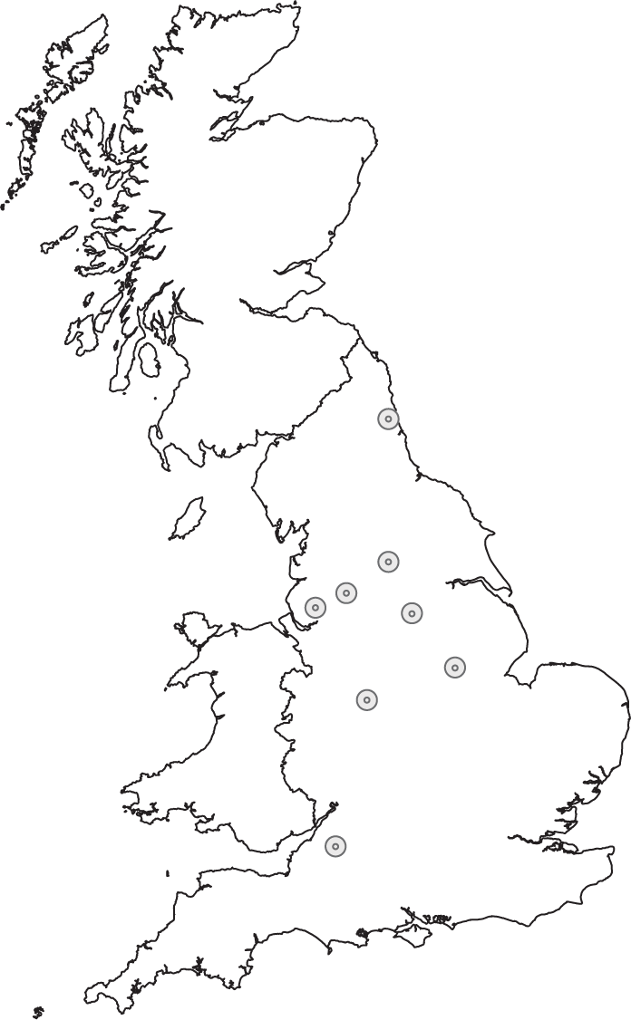
Netherlands-UK Visit
/ Cardiff / Glasgow

Slide 2
Core Cities
Cities are social and economic future
UK highly urbanised
Core Cities – biggest outside London – do well but could do better
Worked together for 20 years on shared priorities
Political Cabinet and Policy Hub structure
Skills and Labour market issues Culture
Smart Cities Transport
Housing Research and Development
Finance and Investment Growth and Business Support
Public Service Reform Energy and Low Carbon
/ Cardiff / Glasgow

Slide 3
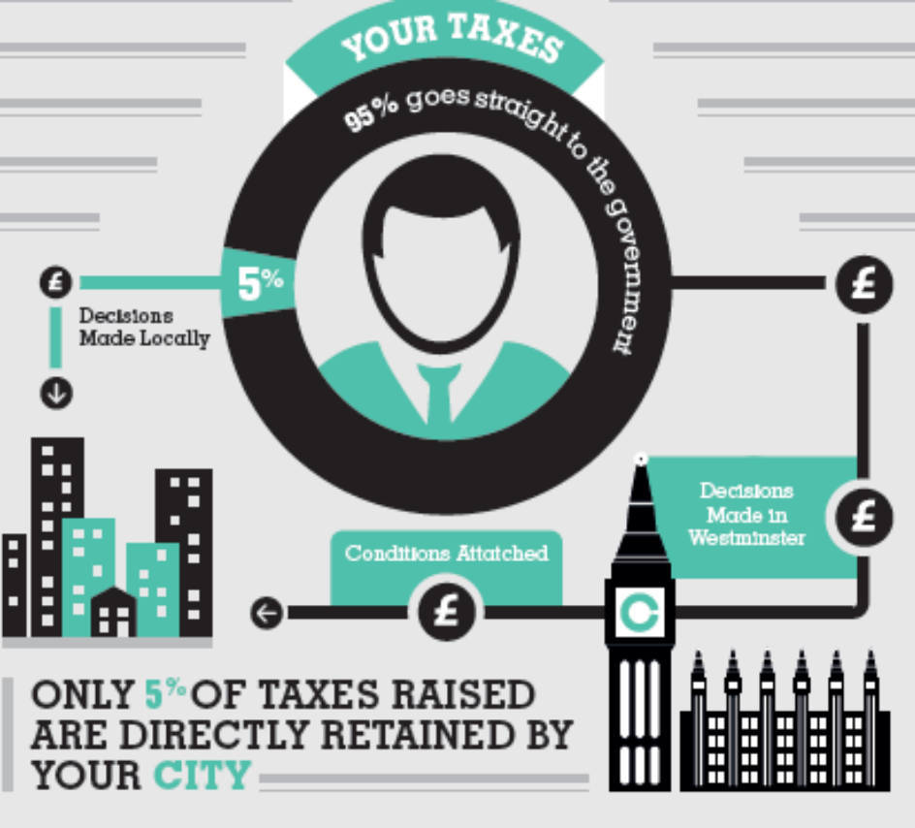
Centralisation and devolution
Cities as solutions, not problems
Cities as delivery partners, not an agency of central govt
UK highly centralised with low levels of tax controlled locally
Scottish impact
The centralisation challenges:
  Economic growth
  Improving public services
  Engaging people in democracy

Slide 4
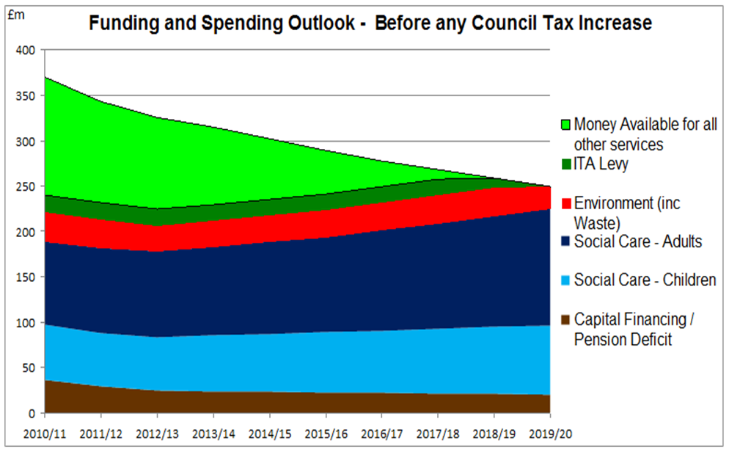
The Future UK context:
Radical and creative Reforms for Sustainable Cities (Funding and spending outlook for Core Cities)

Slide 5
Pillars of Devolution
Economic Powers
Public Services
Fiscal Reforms
  Transport
  Housing
  Skills
  Spatial Planning
  Energy
  Education funding
  Health and Social Care
  Blue Lights
  Double devolution
      Property taxes (inc. HRA)
      Local taxes
      Income tax
      Serious challenges…

Slide 6

Other interventions
Core Cities Prospectus
London Finance Commission
City Centred
RSA City Growth Commission
RSA ‘Devo Met: Charting a Path Ahead
DCLG Select Committee
IPPR Devolution Decade
Think Cities
Devo Me

Slide 7

Progress and next steps
Delivered….
City Deals, Growth Deals and Devolution Deals
New Economic Geography
But….
Functional not fiscal devolution
Individual not embedded process
Needs….
Independent oversight
Outcome and evidence based
Legislative programme
Constitutional Convention
First 100 days
Not just cities

