Slide 1
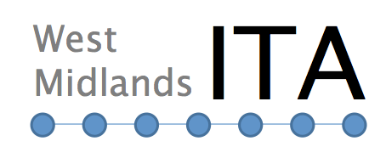
West Midlands Transport Governance
30 March 2015
Adam Harrison
West Midlands ITA Policy & Strategy Team
Notes:
Thank you for inviting me to today's workshop and welcome to Birmingham
I am Adam Harrison and I represent the West Midlands ITA Policy & Strategy Team
We are responsible for the production of the West Midlands Local Transport Plan
In Summary:
I will cover LTPs in a UK context
West Midlands LTP3 and its development;
SUMP policy and our Governance changes
Explain our new Strategic Plan we are developing in the West Midlands

Slide 2
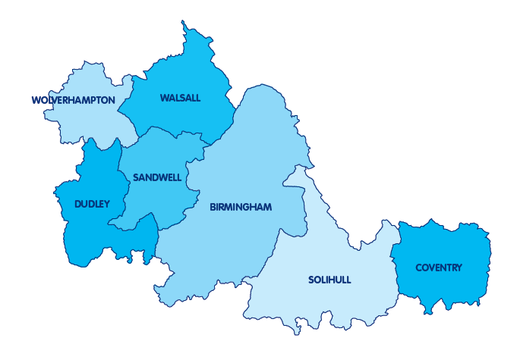
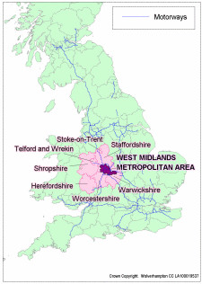
West Midlands Metropolitan Area
Notes:
West Midlands has a 2.7 m population, Birmingham largest city of 1m people.
The area has is in the centre of the UK with an Industrial legacy. Home to famous Global companies such as Jaguar Land Rover.
Area has three distinct sub-regions:
Birmingham/Solihull
The Black Country
Coventry

Slide 3
Decision Making -
Integrated Transport Authority
West Midlands ITA (ITA) comprises of elected members from 7 Districts
ITA is the Local Transport Authority with responsibility for strategic highways, freight, rail, bus and rapid transit networks
ITA set Local Transport Plan (Urban Mobility Plan)
ITA policies implemented by the Passenger Transport Executive – Centro/PTE
Centro/PTE overseen by a Transport Delivery Committee
Notes:
Funded by:
Annual levy on 7 West Midlands Districts
Local Transport Plan
Major Schemes
Developer contributions (Section 106)

Slide 4
Local Enterprise Partnerships
Created after scrapping of English Regional Development Agencies in 2010
New mechanism for promoting and delivering local economic growth
Lead on Economic Development, Inward Investment, Skills and Infrastructure investment
Lead and influence the transport agenda
LEPs support in developing, funding and delivering transport priorities through devolved funding
Co-ordination and delivery of transport programmes

Slide 5
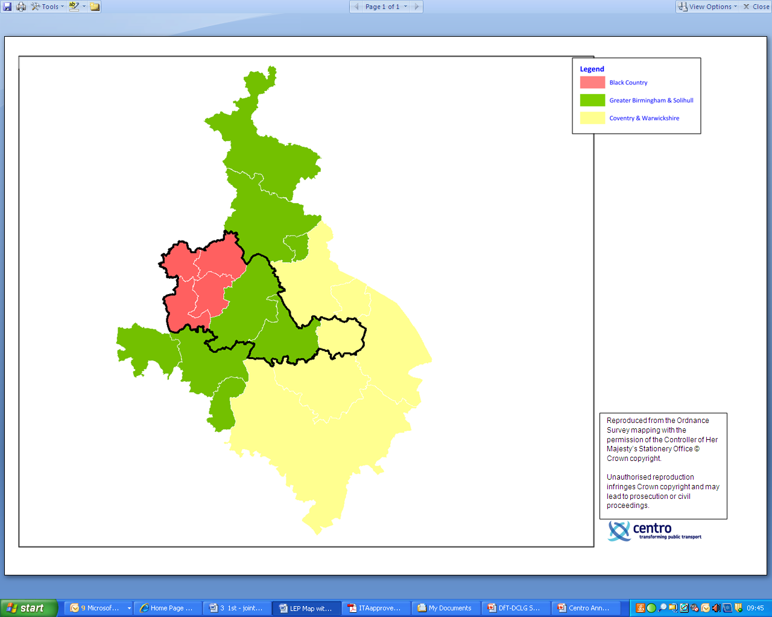
Met Area Local Enterprise Partnerships
Greater Birmingham &
Solihull
Black Country
Coventry & Warwickshire

Slide 6
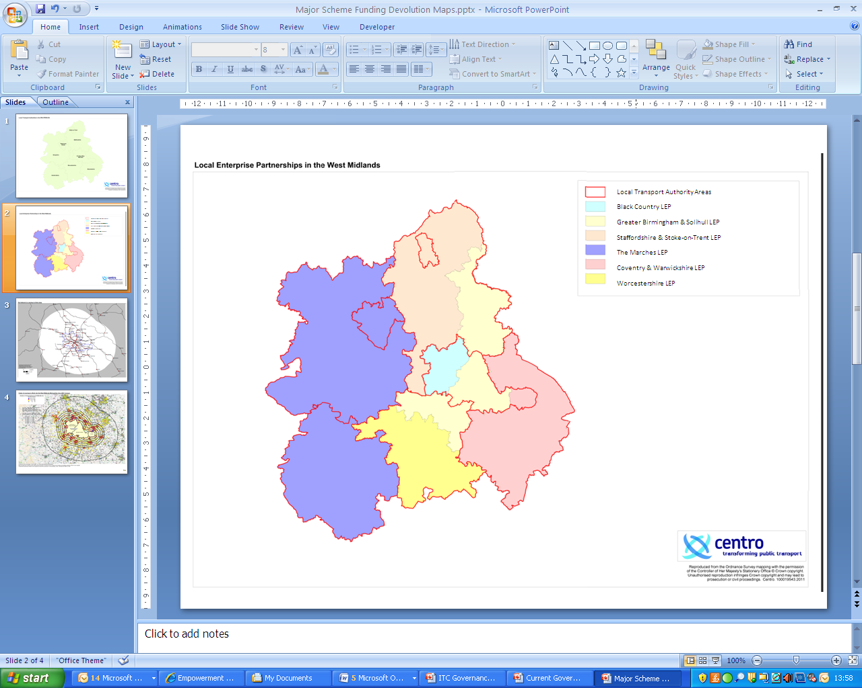
Regional Local Enterprise Partnership & Local Transport Authorities

Slide 7
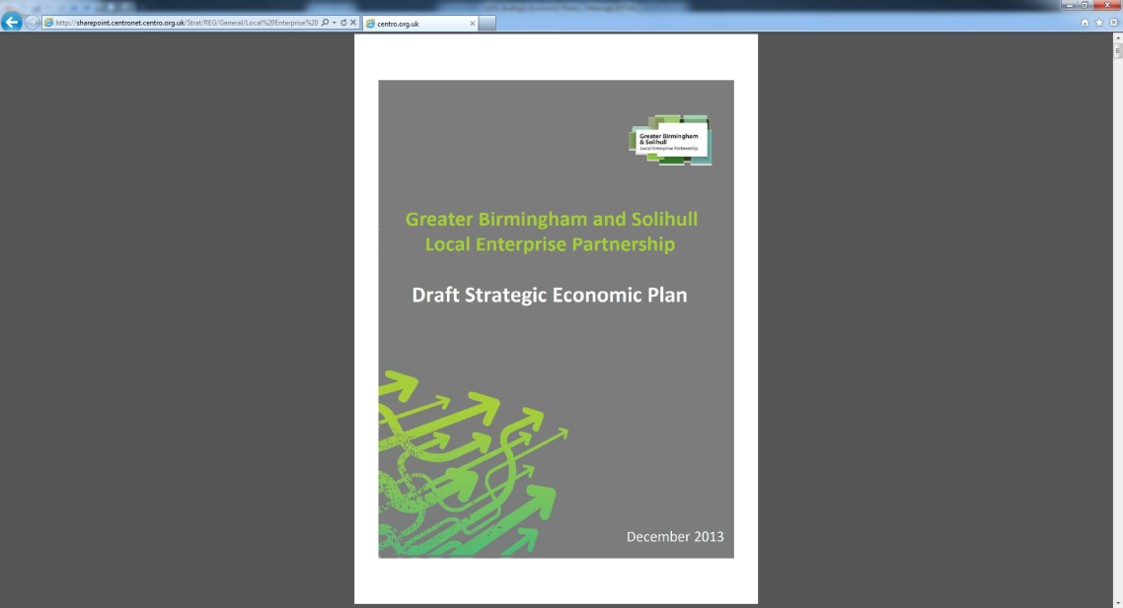
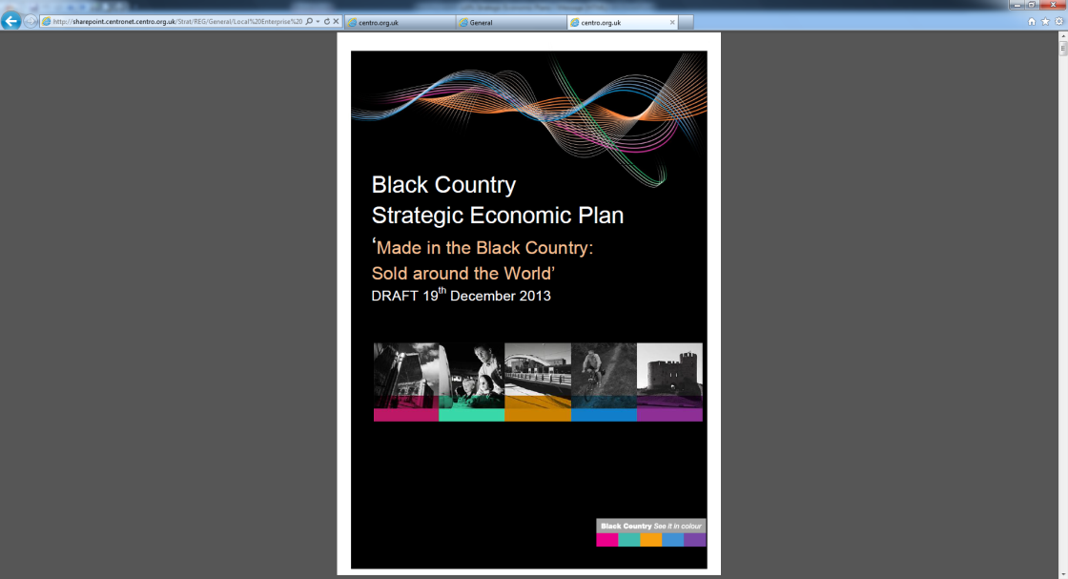
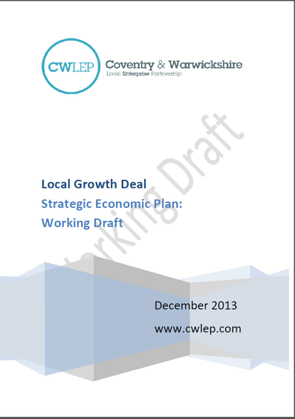
Local Enterprise Partnership Strategic Economic Plans
Set out medium term (5 - 7 year) approach to economic development
Basis for capital funding and devolution of powers from UK Government
Also includes European Union funding

Slide 8
West Midlands Transport Governance Review
West Midlands Local Authorities Leaders are now the Integrated Transport Authority. LEPs non voting members.
West Midlands ITA has formed a standalone Policy & Strategy Team to develop and coordinate transport policy for West Midlands
Addressing Leaders desire for strategic planning and one West Midlands voice on transport matters

Slide 9


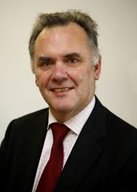

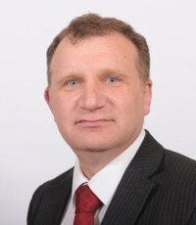

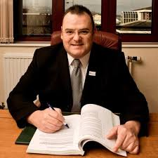



New West Midlands ITA
Led by 7 Council Leaders
Notes:
West Midlands Local Authorities Leaders are now the Integrated Transport Authority
Aims to integrate transport and into a wider public policy agenda. LEPs reps are also non voting members of ITA.
Objective is have ‘One West Midlands Voice’ on transport matters

Slide 10
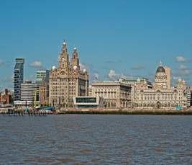
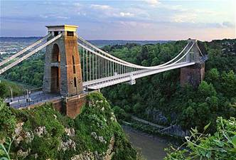
Future Challenges
2035 population - projected increase of 400,000
Which is Liverpool or Bristol added to the West Midlands
Notes:
Bristol or Liverpool population increase 2035 (approx 400,000),
Extra trips but with longer journeys. Complex journeys

Slide 11

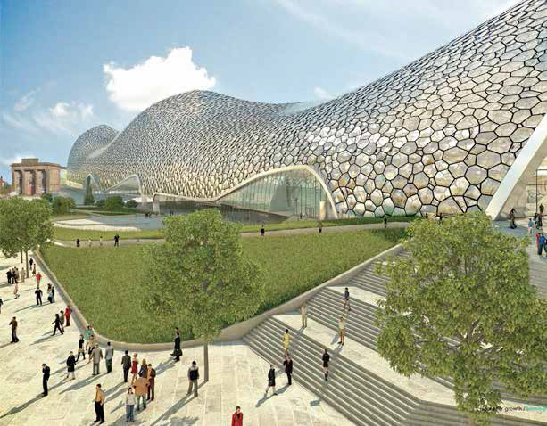
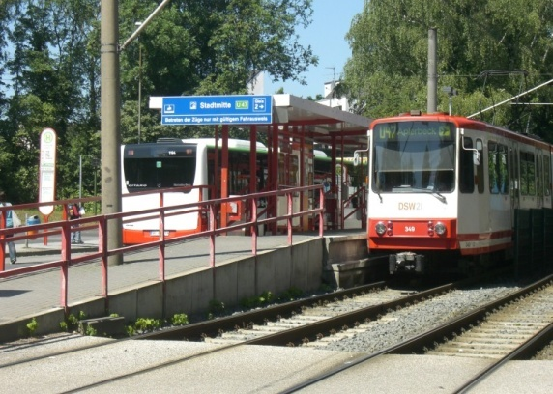
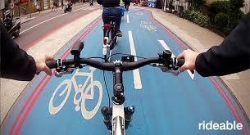
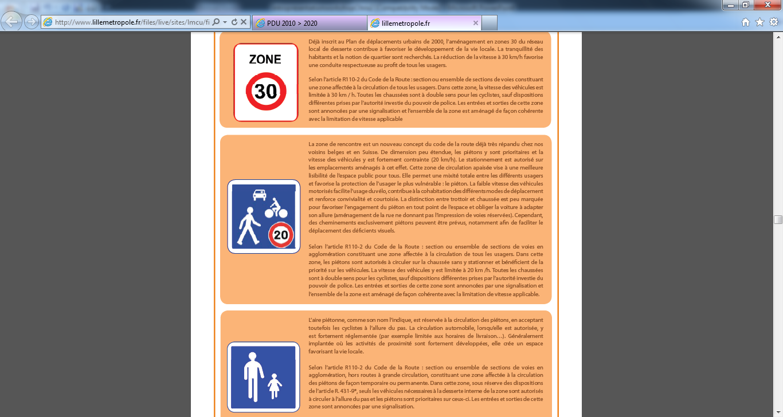
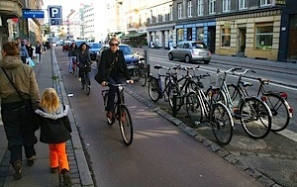
New Strategic Transport Plan
Notes:
Plan based on 4 key tiers:
Connected Midlands (National/Regional Networks) – Excellent connectivity to national destinations, key economic hubs and ports
Connected to Growth (Metropolitan Networks) – ensuring access and connectivity to our key economic hubs from, to and across the Metropolitan Area
Connected People (Local Networks) - Focus on all road users e.g. Pedestrians, cyclists , Car, freight and bus
Connected communities: Ensuring ease of use, improving the individual’s experience of travelling through better information, ticketing, greater influence on services through devolution

Slide 12
Coherent Approach
4 Tiers
Connected Midlands - Excellent connectivity to national destinations, key economic hubs and ports
Connected to Growth - Ensuring access and connectivity to our key economic hubs from, to and across the Metropolitan Area
Connected People - Focus on all road users e.g. Pedestrians, cyclists , car, freight and bus
Connected Communities - Improving the individual’s experience of travelling through better information, ticketing, greater influence on services through devolution
Notes:
Structure – Indicative schemes around the 4 tiers / Plan builds on SEPs and LTP3:

Slide 13
Summary
Previous Metropolitan Area structures complex, with conflicting geographies & roles
New arrangements coordinates work of ITA and LEPs, working together with One Voice
New Strategic Transport Plan being developed to improve quality of life and Urban Mobility
ITA could be replaced with Combined Authority in the future, with merged LEPs too
Notes:
Combined Authorities merge Economic Development and Strategic Transportation

Slide 14
Adam Harrison
Policy Advisor
AdamHarrison@wmita.org.uk
0121 214 7316
www.wmita.org.uk
@WestMidlandsITA

