Slide 1
The Rise of Collaborative Working in Birmingham
Patrick Willcocks

Slide 2
aboutme
#cities #birmingham #london #manchester #europe #innovation #climatechange #digital #tech #sustainability #urbanpolicy #devolution #local authorities #cityregions #combined authorities #photography #digbeth #jewelleryquarter #balsallheath #moseley #kingsheath #stokenewington #dalston #camden #coworking #collaborativeworking

Slide 3
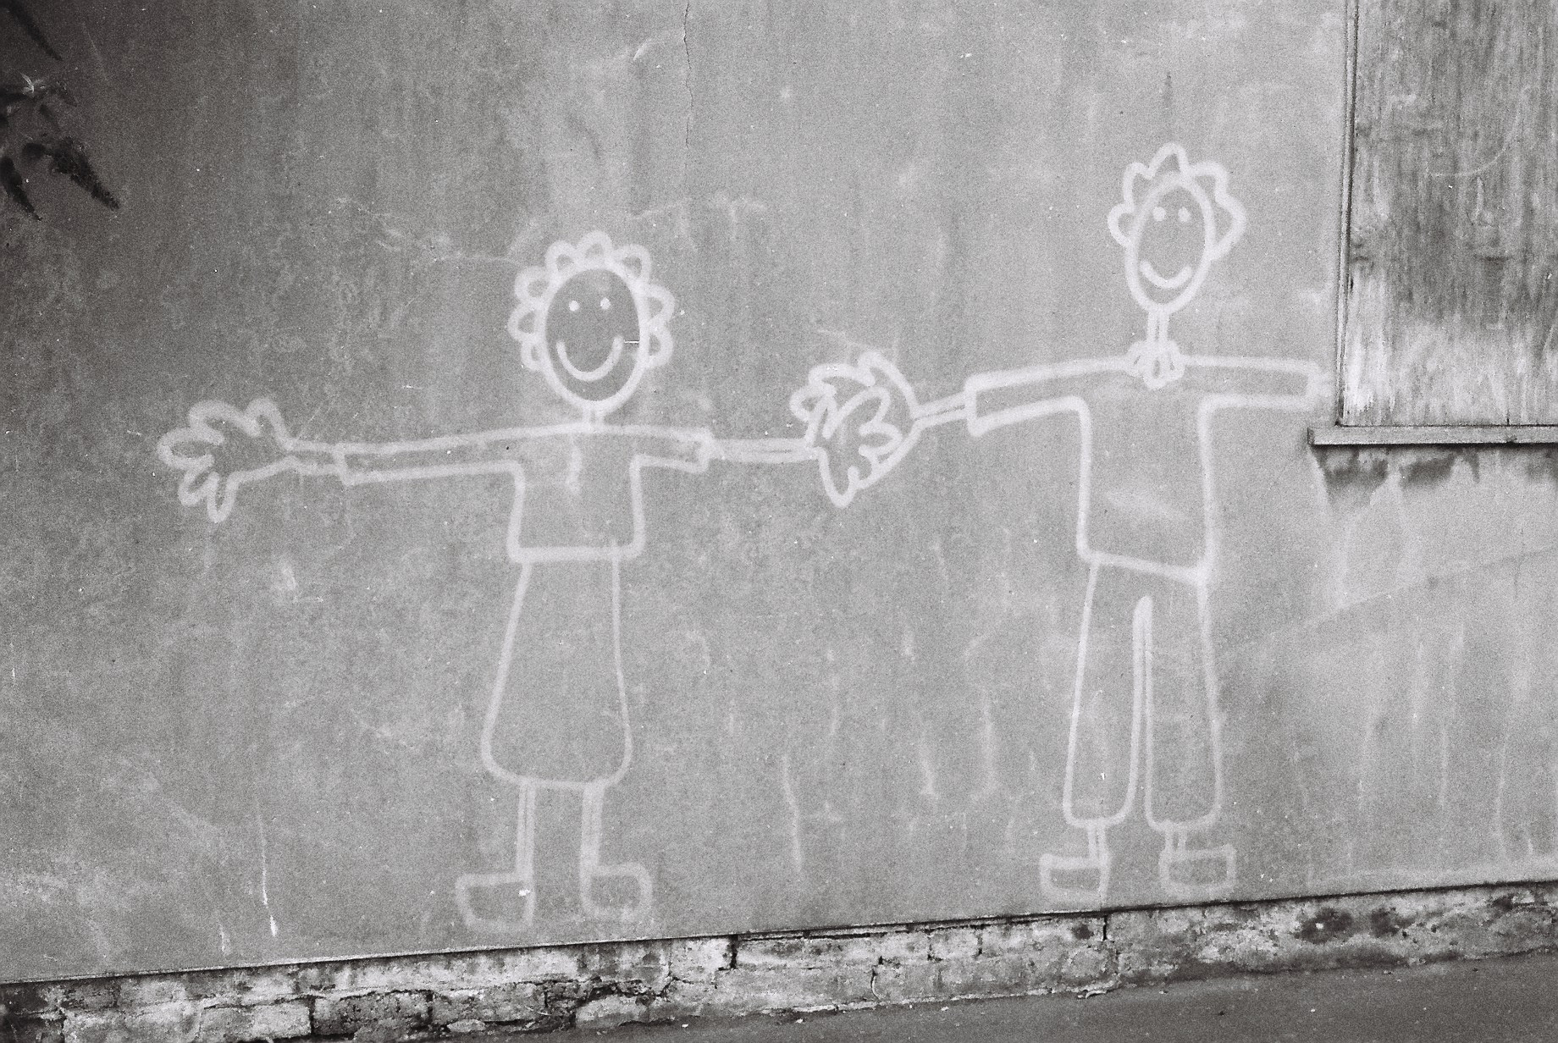
WHAT IS COLLABORATIVE WORKING

Slide 4
What is Collaborative Working
It can be almost entirely digital
Physics paper sets record with more than 5,000 authors
(Work on the Higgs Boson)
But in Cities – it almost always involves a MEETING SPACE

Slide 5
Types of Spaces
Cafés
Co-working spaces
Maker Spaces
Producer Spaces
Fab Labs
Living Labs…………

Slide 6
What makes a good collaborative space
Openness and visibility
A Community – not just the space – but often a real and a digital community
A vision/aim as to what it is setting out to achieve
A great café (Ort Café is a case in point)
Design is a key element – both in the space, in building the community and in marketing
n
Good digital connectivity
Easy terms / low cost
Need most of these

Slide 7
Why are Policy Makers Interested
The importance of Serendipity
Some of the greatest inventions and new ideas for products/services have come from diverse teams/ random meetings/ chance encounters
Innovation just doesn’t happen in Science labs.
The UK and the EU needs to innovate more – hence the interest in such spaces – across the EU

Slide 8
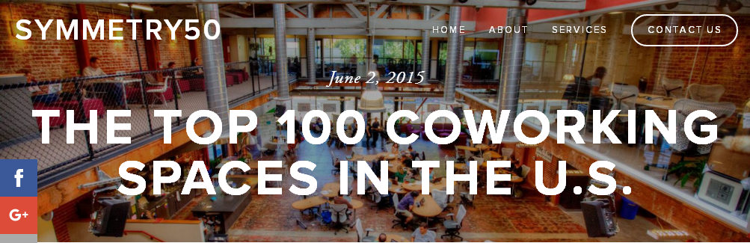
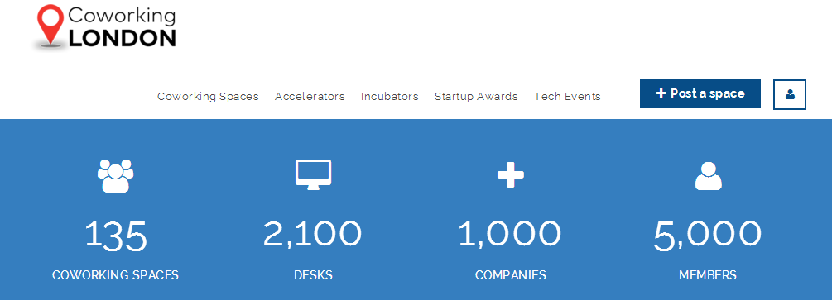
Not just Birmingham
Worldwide phenomena
Like to briefly focus on two networks – Impact Hub and Seats2Meet

Slide 9
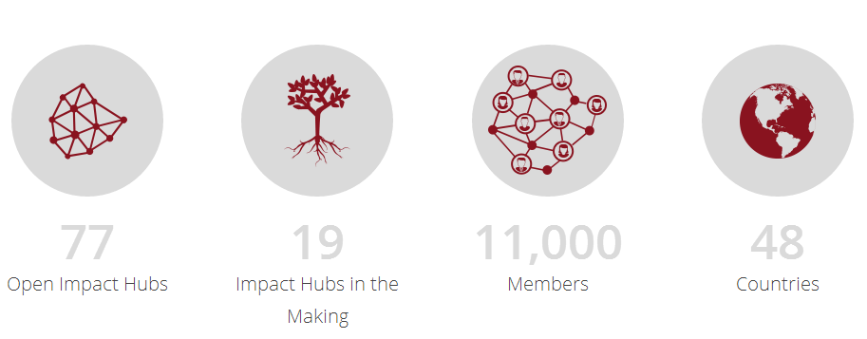
Impact Hub Network
We are a network of collaborators focused on making a positive impact in our world. We are you. We are the people you've been wanting to work with.

Slide 10
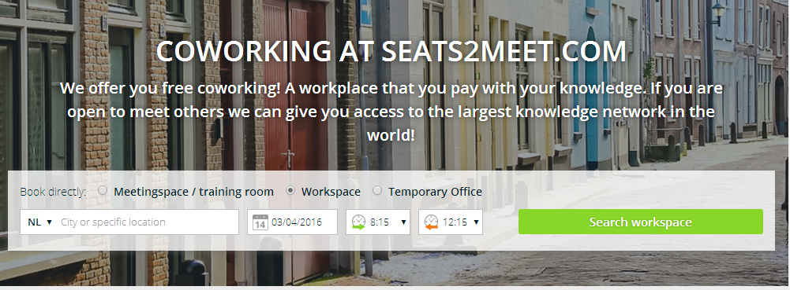
Seats2Meet
90 locations – mostly in the Netherlands – but worldwide
Free co-working
Great skills matching software

Slide 11
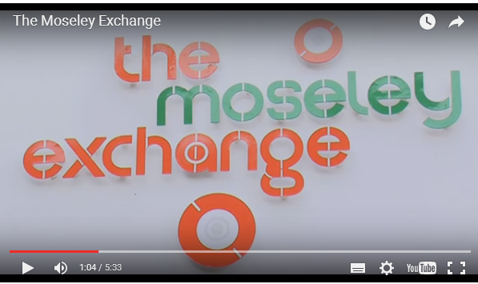
So lets not forget Birmingham
It all started with the Moseley Exchange
Opened June 2013
Focussed on the arts and creative sector
50 people work from there
Moseley Exchange has been great for Moseley

Slide 12
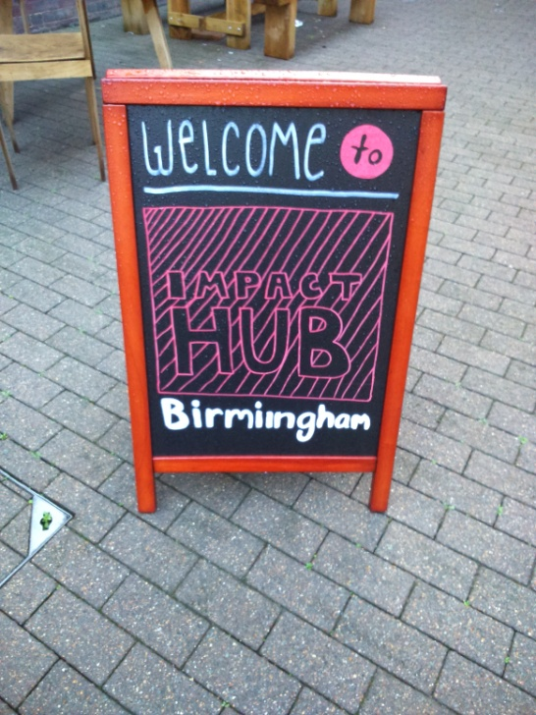
Let talk about Impact Hub Birmingham
Opened in 2015 in Digbeth
Real energy behind it – down to the founders
Real community/real digital community
Exemplar for non public sector supported
action
Events on regularly – raising the level of
discussion and debate in the city
Practical/positive outlook – eg Birmingham Soup
Ethos – Third way activism
National profile

Slide 13
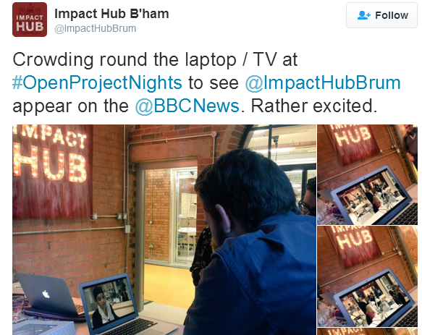
Let talk about Impact Hub Birmingham
National profile
And working with NESTA

Slide 14
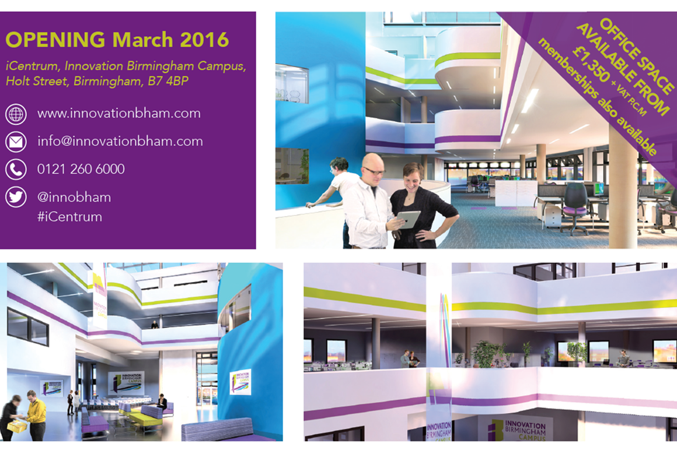
ICentrum at Innovation Birmingham
Policy makers have bought into
Serendipity in a big way - £8m
centre – opening this month
Focussing on cross innovation
– bring different sectors together to look at opportunities for innovation
‘'Serendip Smart City Incubator', an 11,845 sq ft accelerator programme facilitating collaboration between start-ups and corporate partners’
space for up to 400 people to work from it

Slide 15
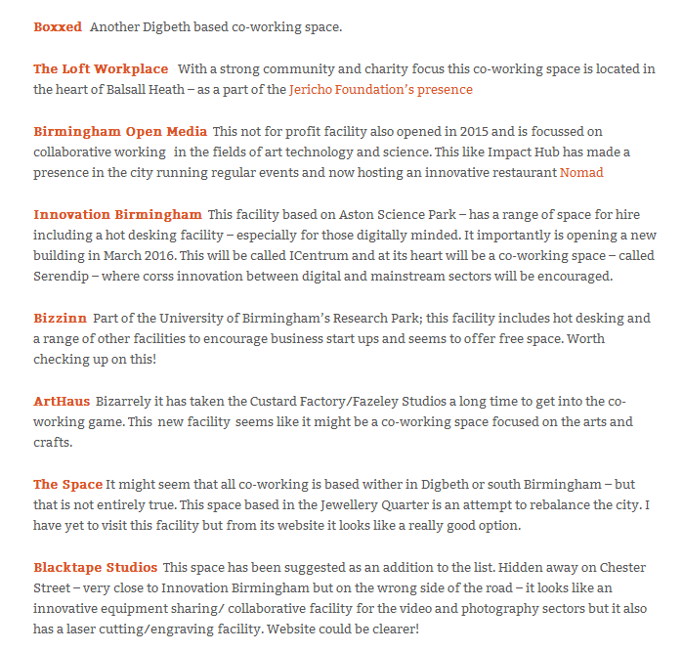
Other Birmingham Facilities
List on my website – BirminghamPivot
and now we have ‘The Transfer’…

Slide 16
Why is it happening – my thoughts?
Fewer large employers/manufacturing has gone East
Employers that remain have downsized and
outsourced – so growth in small firms
Rise of the knowledge economy/services
Digital allows for it and also needs it
Flexible working/dislike of commuting
Failure of traditional methods to tackle society’s
problems
Hard to work from home/rise of generation rent……

Slide 17
Producer Spaces - Birmingham
Growing interest in producer spaces – ‘making’ often now combined with digital
We are here in the ‘original’ maker space in Birmingham. The Old Printworks
We are planning a ‘skills shed’ – like the Moseley and Kings Heath shed where people can come along and use a set of woodworking/metal working tools
Interest is growing in the city with the combination of maker spaces with digital – Fab Labs etc. Again this is a European trend.
Talk about two projects - STEAMhouse and Maker Wharf

Slide 18
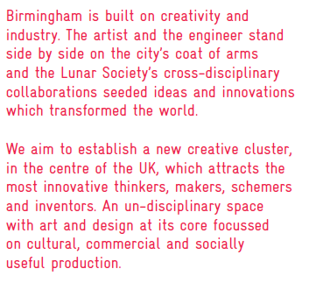
STEAMhouse Phase 1 and Phase 2
Eastside Projects and BCU
driving this
Phase 1 – got £500k from the
Arts Council and hoping to
get £500k from European
funds

Slide 19
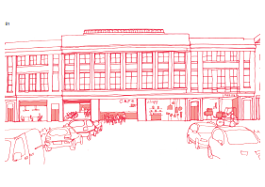
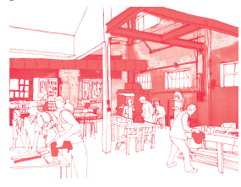
STEAMhouse Phase 2
Phase 2 looking at locating in
Typhoo Wharf, Digbeth
The STEAMHouse campus will create 93,000 sq ft of incubator, collaboration, making and innovation space in Digbeth, in the centre of Birmingham, providing a catalyst for the creative industries.

Slide 20
Makers Wharf at Innovation Birmingham
‘incorporating a FabLab (3D printing) prototyping facility on the ground floor’

Slide 21
And Finally Who are the Drivers
Community/Third Sector Organisations
Private Sector
Steve Harding and BCU
Immy Kaur from the Impact Hub
David Hardman (Innovation Birmingham) and Ruth Claxton (Eastside Projects)

Slide 22
Any Questions?
@UrbanPivot
@BirminghamPivot
urbanpivot.com
birminghampivot.wordpress.com

